Slide 1

BATTLE OF NEIGHBORHOODS-FINAL REPORT
Sai Ramachandran

Slide 2

Business /Data
Introduction & Context
2

Slide 3
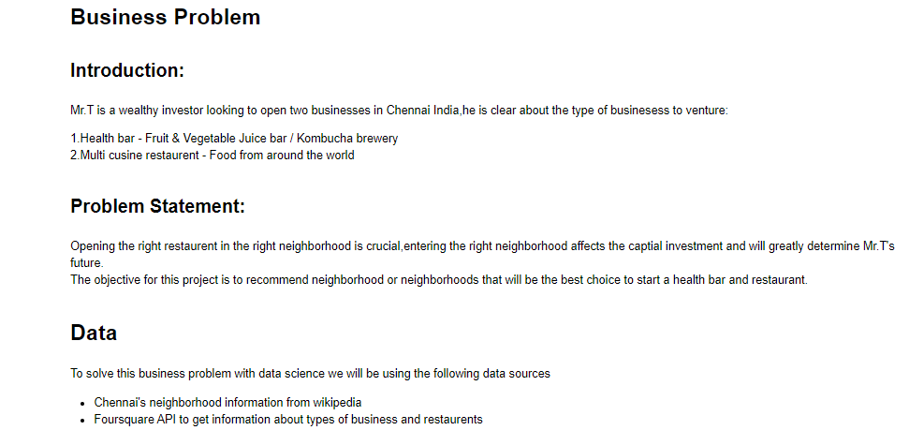
Business Problem/Data

Slide 4
Methodology/Code
Python
4

Slide 5
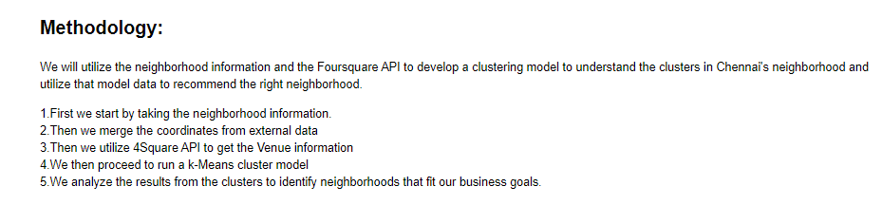
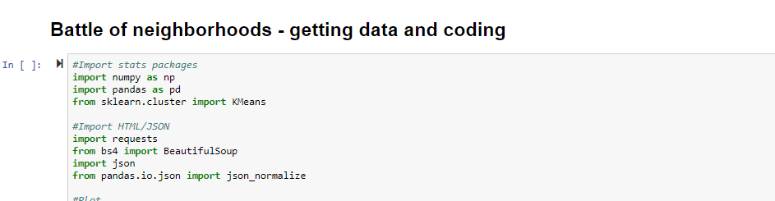
Methodology/Coding

Slide 6
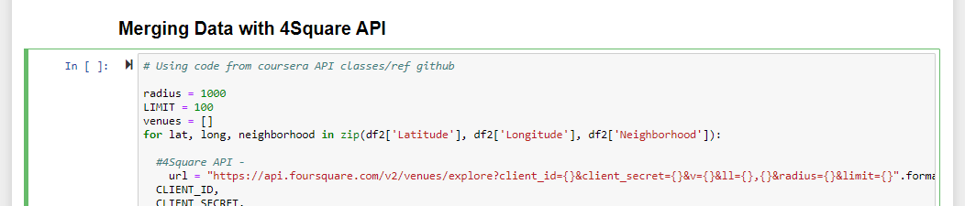
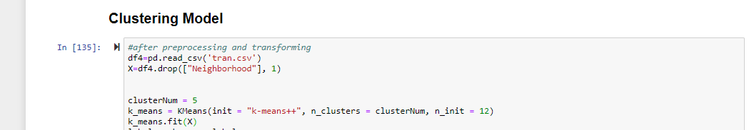
Coding Contd..

Slide 7
Discussion/Conclusion
7

Slide 8
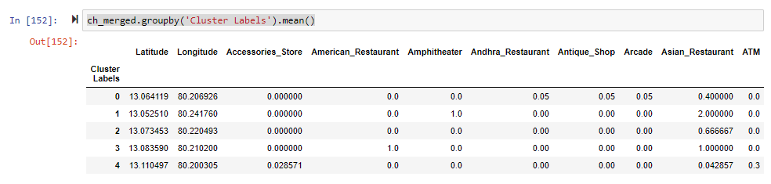
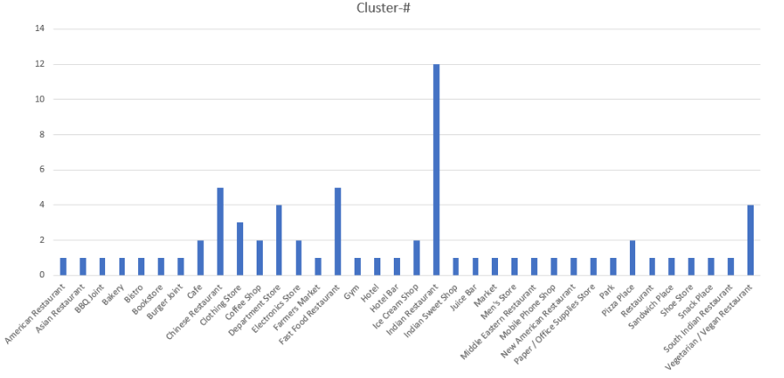
Analyzing Results/Discussion

Slide 9

Quote and Image Slide
“
From the cluster analysis it is evident that most of the neighborhoods are not unique except cluster 3 and 5-further analyzing the results we can see that Neighborhood-Anna Nagar is very unique.
“The conclusion of this report is that Mr.T should open his businesses in Neighborhood -ANNA NAGAR”
9

Slide 10
THANK YOU
Insert Image

